Slide 1
J.N GRAY R.A LORIE IBM RESEARCH LAB, SAN JOSE, CALIFORNIA
GRANULARITY OF LOCKS IN A SHARED DATABASE

Slide 2
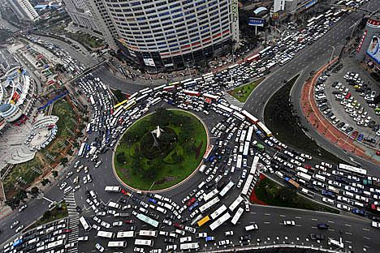
Why Locking ?
When multiple users access the same data, they need to avoid clobbering each others work.
Database must restrict the access to one user at a time for a table or a row.

Slide 3
Granularity ?
Data is divided into levels.
Granularity is the size of data item allowed to lock.
Idea is to improve efficiency.
Problem?
What is the appropriate granularity of lockable objects in data base?

Slide 4
BACKGROUND
Fine lockable unit = Increases concurrency for simple transactions. However, increases overhead for complex transactions.
Coarse lockable unit= Lower overhead for complex transactions. However, reduces concurrency too for simple transactions.

Slide 5

The choice of lockable unit is Tradeoff !
Concurrency:
The ability to have one transaction work with one set of resources while another transaction “Simultaneously” works with others
WHAT WE WANT
Overhead:
The amount of file structure, memory and processing time needed to keep those different transactions from affecting each other undesirably
WE DON’T WANT

Slide 6
Granularity of Locks
Locking only the exact record being examined allows for maximum concurrency
However, if there are a lot of lockable objects, then the overhead increases:
Takes time to set/reset locks.
Storage overhead of representing lock in memory.
Solution : Allow for multiple granularity locking in the same system.

Slide 7
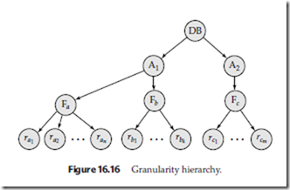
Granularity Hierarchy
Database
Areas
Files
Records
Locking level is NOT FIXED. It is decided based on the requirements !

Slide 8
Types of Locks
Exclusive lock (x) :
Requester has exclusive access to that node and its descendants (for writes)
Shared lock (s):
Requester has shared access to that node and its descendants (for reads)
Requesting a lock on a node in the hierarchy implicitly locks the descendants of the node as well.

Slide 9
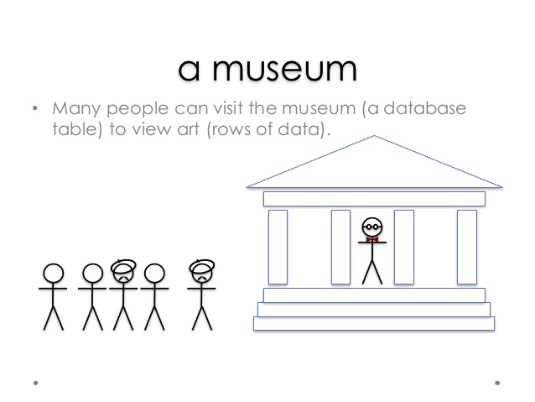
Analogy
Reference: https://www.slideshare.net/billkarwin/innodb-locking-explained-with-stick-figures

Slide 10
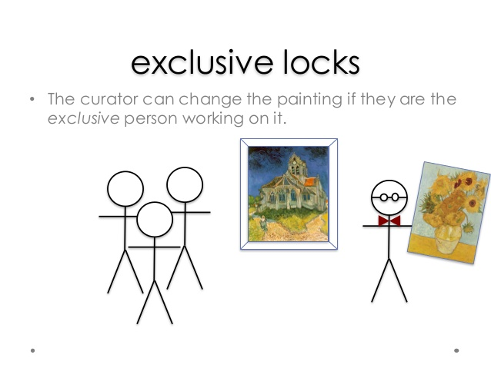
Analogy

Slide 11

Analogy

Slide 12
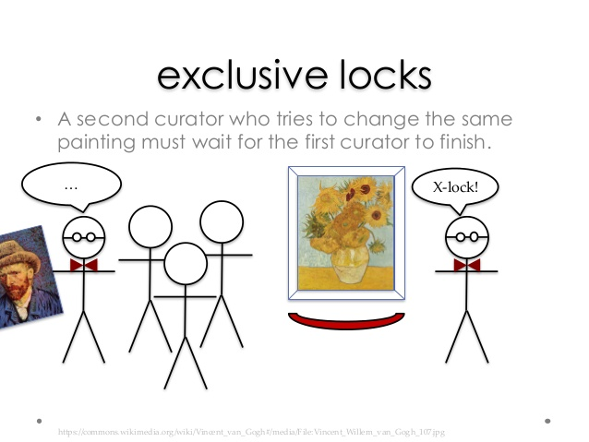
Analogy

Slide 13
Exclusive locks revisited
A lock that does not share
It must be the only lock on the resource
Request for an exclusive locks waits for any other locks on the resource.

Slide 14
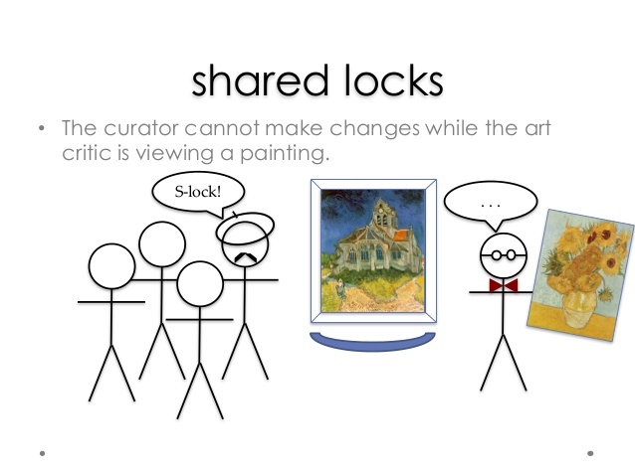
Shared lock Analogy

Slide 15
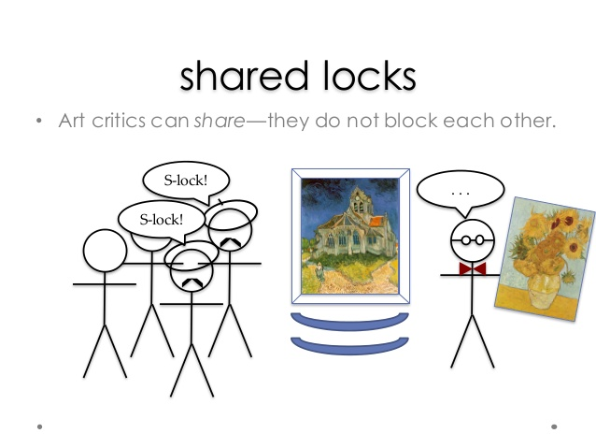
Analogy

Slide 16
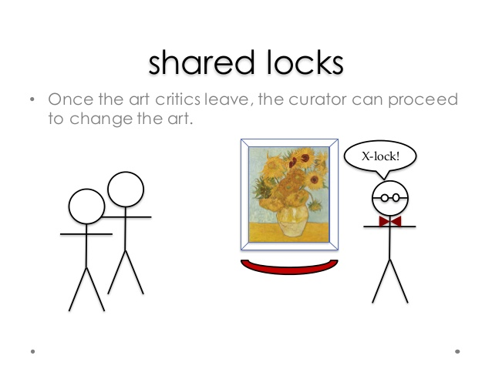
Analogy

Slide 17
Shared locks revisited
A lock that shares with others
It blocks exclusive locks

Slide 18
Problem?
T1 has an s lock on a record of a file.
T2 has an x lock on whole file.
How can T2 discover that T1 has locked the record?

Slide 19
Intention Locks
Tags all the ancestors of a node to be locked in s or x mode.
Signals the intention of locking at finer levels.
Prevent locking of the entire subtree by locking ancestors with x or s mode .
Allow us to work with higher node, and still avoid changes
that might conflict with the lock further down
-- increases concurrency
T1 gets an s-lock on record but first gets an intention (IS) lock on file
Now T2 can get x-lock on file

Slide 20
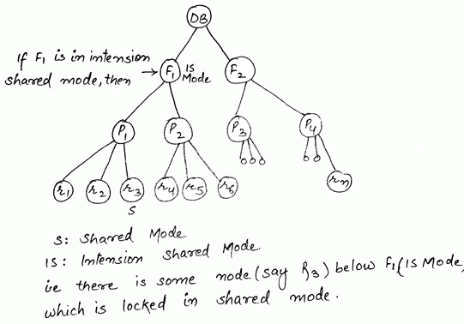
Intention Locks
Intention Share (IS) : Gives intention share access to the requested node and allows the requestor to lock descendant nodes in S or IS mode. (No implicit locking)

Slide 21
Intention Locks
Intention exclusive (IX):Gives intention exclusive access to the requested node and allows the requestor to explicitly lock descendants in X, S, SIX, IX, or IS mode. (No implicit locking)
Suppose we need to access the entire subtree and update particular nodes of the subtree, which mode will be used?

Slide 22
Intention Locks
A. Exclusive lock to root and no further locking
OR
B. IX lock on root of subtree and explicitly locking child nodes in intention, share or exclusive mode
A results in low concurrency
B results in high overhead
Solution:
Shared access to subtree, giving read access to all. Allowing X locks to only those which needs to be updated and IX or SIX locks to intervening nodes.

Slide 23
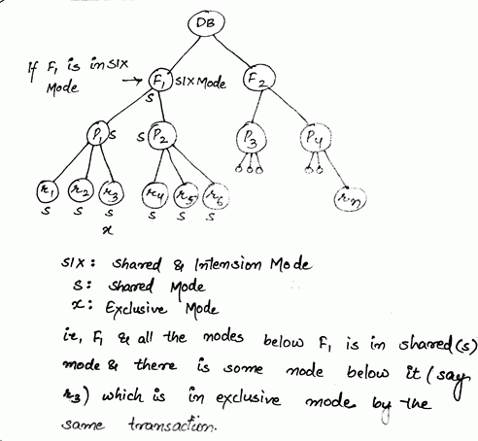
Intention Locks
Shared Intention Exclusive(SIX): Implicitly locks all the children of the node in shared mode and explicitly allows to lock child in X,SIX,or IX mode. (No implicit locking)

Slide 24
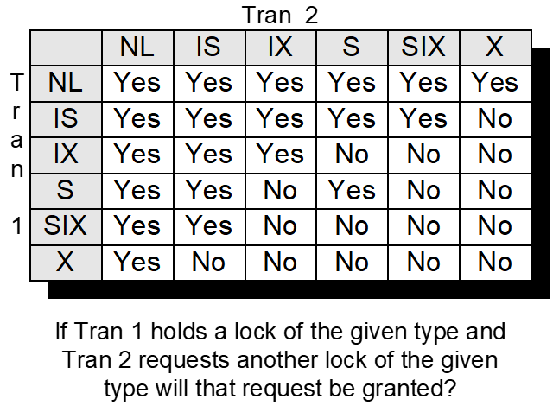
Access mode compatibility
Null mode (NL) represents absence of requests of a resource by a transaction

Slide 25
Rules for requesting nodes
Must observe the lock compatibility
Root of the tree must be locked first in any mode
Before requesting S/IS lock on a node, all ancestor nodes must have IX/IS lock.
Before requesting X/SIX/IX lock on a node, all ancestor nodes must have SIX/IX lock.
Locks should be released in leaf to root order.
A transaction can unlock a node only if none of its children are currently locked.

Slide 26
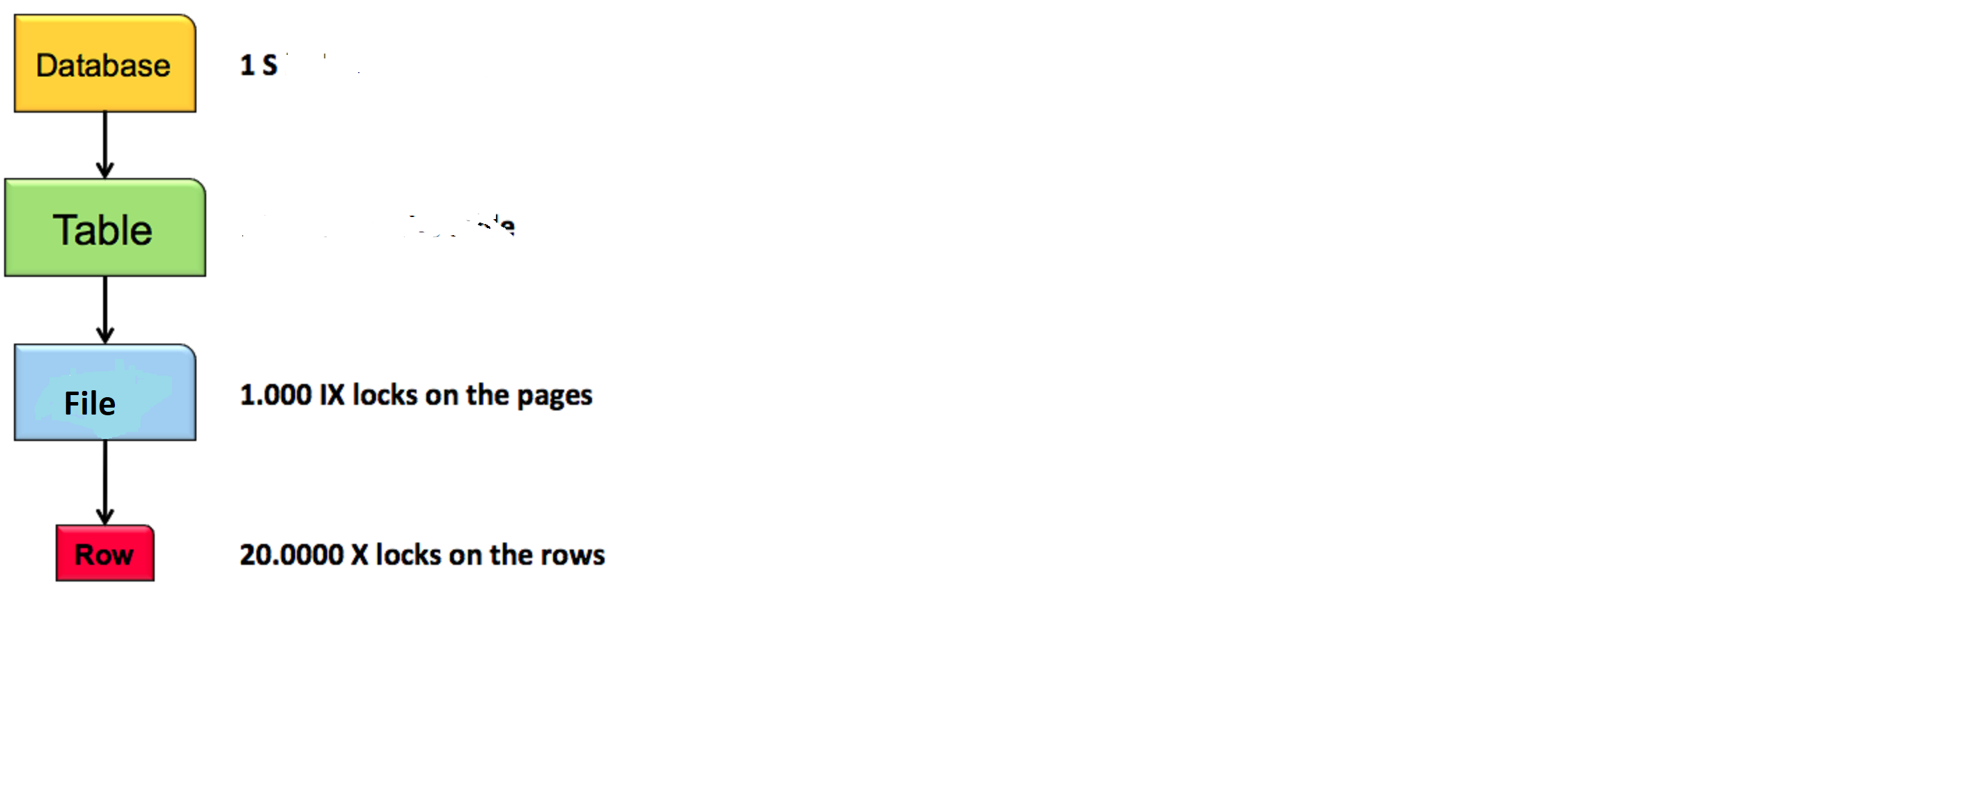
Examples
Lock record R for Write-exclusive access:
IX
IX
IX
X

Slide 27
Examples
Lock a record R for read:
IS
IS
IS
S
Note: If the records of this and previous example are distinct , each request can be granted simultaneously to different transactions even though they refer to same file.

Slide 28
Examples
To lock a file F for complete scan and occasional updates:
DataBase
Table
File
IX
IX
SIX
Note: This transaction is compatible with the previous example

Slide 29
Directed Acyclic Graph of locks
The tree locking hierarchy can be generalized to all directed acyclic graphs(DAG)
To lock a node in DAG , all parents must be locked in appropriate mode.
A node is locked in S mode if ANY of the parents are explicitly or implicitly locked in S,SIX or X.
A node is implicitly locked in X mode if ALL of its parents are locked in X mode.
Note: Rules for requesting a lock is similar to hierarchy based locking.

Slide 30
Requesting Locks in DAG
Before requesting an S or IS lock on a node, one should request at least one parent in IS mode
Before requesting IX, SIX, or X mode access to a node, one should request all parents in IX (or greater) mode
When releasing locks, one should never hold a lower lock having released its ancestors (or it should release all locks when the transaction is complete)

Slide 31
Dynamic Lock graphs
So far the lock graphs were static.
Areas, files indices are dynamically created and destroyed as records are inserted and deleted .
Index is partitioned into lockable key value intervals
Example: Lock all the records in account file where location field(key) = napa (value).
Advantage: Instead of locking the index or record, we can lock all records with a certain index value.

Slide 32
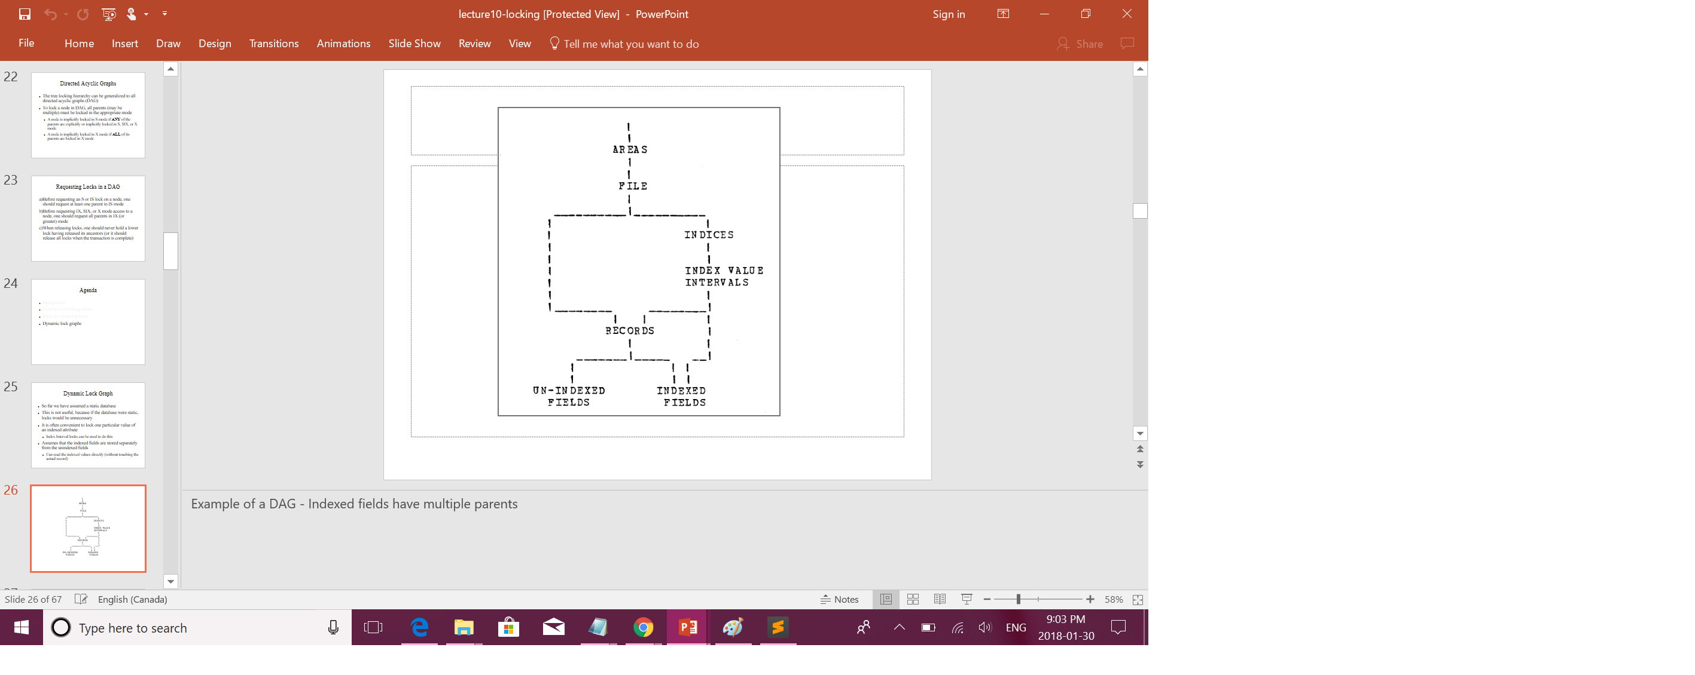
Dynamic locks
Key value interval is the parent of records and indexed field.
An index value interval has a record id and field value so we can read the filed directly without touching the record.
Update: When an indexed field is updated, it and its parent record move from one interval to another interval.
Insert: When record is inserted, it joins the interval containing the field value.
Delete: Removes the records form the interval and the file.

Slide 33
Example
Move Napa account to St.Helena branch:
Lock database: IX mode
Lock area : IX mode
Lock accounts file: IX mode
Lock location index: IX mode
Lock Napa interval: IX mode
Lock Helena interval: IX mode
Lock record: IX mode
Lock field: X mode

Slide 34


Questions???

